Slide 1

IAA Secondary School 2021-2022
Secondary Meet & Greet: Grade 11
We’ll start at 2.35

Slide 2
The afternoon
Subject | Time
Welcome | 2.35 – 2.40
Welcome (Pastoral) | 2.40 – 2.45
Arabic A | 2.45 -2.50
English A | 2.50 – 2.55
English B | 2.55 – 3.00
Arabic B/Ab In | 3.00 – 3.05
Spanish B | 3.05 – 3.10
Business/Economics | 3.10 – 3.15
Global Politics | 3.15 – 3.20
Psychology/ESS | 3.20 – 3.25
Design | 3.25 – 3.30
Physics/Computer Science | 3.30 – 3.35
Biology/Chemistry | 3.35 – 3.40
Maths Analysis | 3.40 – 3.45
Maths Applications | 3.45 – 3.50
Visual Arts | 3.50 – 3.55
TOK | 3.55 – 4.00
Grade 11
Diploma Programme meeting
Tuesday (7th September) at 2.35 pm.
Please note slight change of schedule for English B and Arabic B

Slide 3
اللغة (أ ) الأدب- المستوى العادي:
أقسام المنهاج:
أعمال مترجمة: ثلاثة منها قصة موت معلن لماركيز،الآنسة جوليا: ستراندبرغ
أعمال أصيلة أربعة :الحرام-يوسف إدريس،رجال في الشمس غسان كنفاني،ساق البامبو سعود السنعوسي
أعمال تختار بحرية 2 قصائد للشاعر نزار قباني-مجموعة قصصية
إجمالي الأعمال المدروسة 9
قراءة الدراسات المتعلقة بهذه الأعمال (رسائل جامعية)
التقييم الخارجي: 3 ساعات 70%
الورقة الأولى: التحليل الأدبي الموجّه مدة الامتحان(1.15)
تتكون الورقة من شكلين أدبيين مختلفين
المطلوب أن يختار المتعلّم إحدى الفقرتين ويقوم على تحليلها تحليلاً أدبياً موجهاً مستنداً في إجابته على سؤال استرشادي (20 علامة)
الورقة الثانية: المقال المقارن مدة الامتحان (1.45)
تتكون الورقة من أربعة أسئلة عامة.
المطلوب:أن يكتب المتعلم مقالاً معتمداً على عملين على الأقل من الأعمال التي سبقت دراستها.(30 علامة)
التقييم الداخلي: 30 %
التقييم الشفهي الفردي: (15) دقيقة
يقيم داخلياً من قبل المعلم ويعاير خارجياً
يقدم الطالب استجابة مجهزة (كيفية عرض القضية العالمية من خلال الشكل والمحتوى لمقتطفين (أصيل ومترجم)
مدتها 10 دقائق ثم أسئلة المعلم 5 دقائق(40 علامة)
المرأة-الهجرة-الحرب-السلام-الطبقية-النزاعات.....القيم-الأخلاق

Slide 4



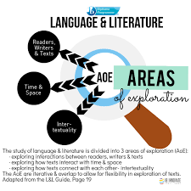
English A
Six literary texts
Bodies of work from a range of genres (articles, blogs, advertisements, images).
Global issues
Contemporary
Relevant on a global scale
Applicable to local contexts

Slide 5



English B HL
Aims:
Enable students to communicate in the language they have studied in a range of contexts and for a variety of purposes.
Encourage, through the study of texts and through social interaction, an awareness and appreciation of a variety of perspectives of people from diverse cultures.
Develop students’ awareness of the importance of language in relation to other areas of knowledge.
Assessments Components:
Paper 1 Writing – 25%
Paper 2 Listening and Reading Comprehension – 50%
Internal Assessment Individual Oral - 25%

Slide 6
المستوى العالي والعادي
يُقيم الطالب من خلال :
1- الورقة الأولى ( مهارة الكتابة )
2- الورقة الثانية ( مهارة الاستماع ومهارة الفهم والاستيعاب)
3- العرض الشفوي الفردي
يُبنى المساق على خمسة محاور وهي: 1- التنظيم الاجتماعي 2- نتشارك الكوكب 3- البراعة البشرية 4- الهوّيات 5- التجارب

Slide 7
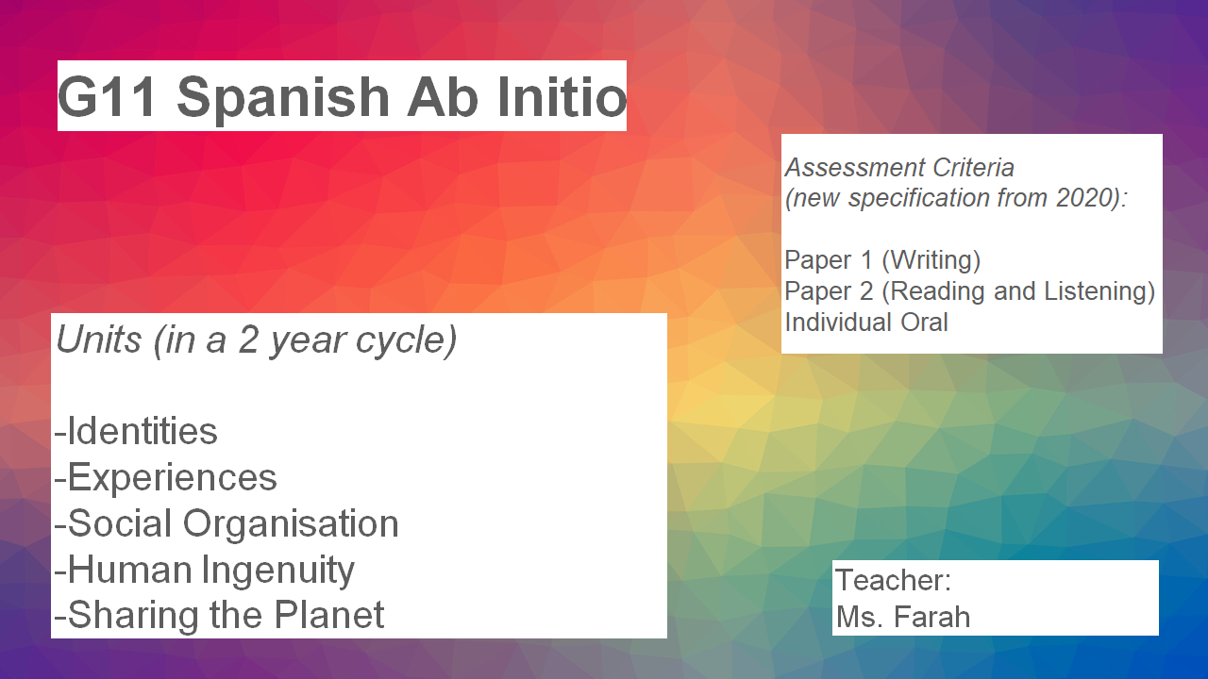

Slide 8
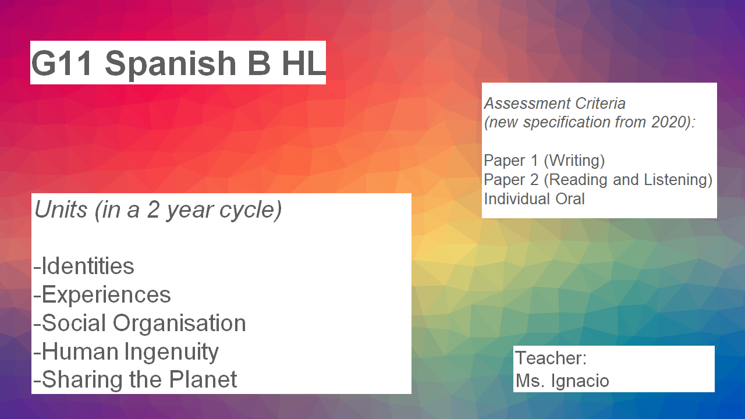

Slide 9
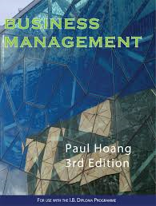

Business Management
ATL:
Concepts
Content
Context
Unit One: Business Organization and Environments
Unit Two: HR
Unit Three: Finance and Accounts
Unit Four: Marketing
Resources:
* BM text
* PPT slides
* Kognity
*Google Classroom
* Inthinking BM
Unit Five: Operations
Management
Distinction between SL & HL
• Teaching hours devoted (240 hours for HL compared to 150 hours for SL)
• Extra depth and breadth required (extension units for HL)
• Nature of the IA task
• Nature of the examination questions.
Ms. Reem Amireh
Mr. Justin Hayward

Slide 10
IB economics 2022
This is a new syllabus and this group of students will be the second cohort to sit for the exam in 2023
Microeconomics, macroeconomics and the global economy are the modules within the course and they will be covered over a span of two years
We have a portfolio of three internal assessments and they comprise 25% of the final mark for HL students and 30% for SL students
It is paramount that students research various topics and follow current events as the course requires empirical examples and evidence in the external assessment
The Economist, Financial Times, Wall Street Journal to name a few are good sources to find articles for the internal assessment and empirical evidence for assessments
Trading Economies, the IMF and World Bank websites are also good sources for the research
A valuable website to access nearly 11,000 publications is: https://www.thepaperboy.com/

Slide 11
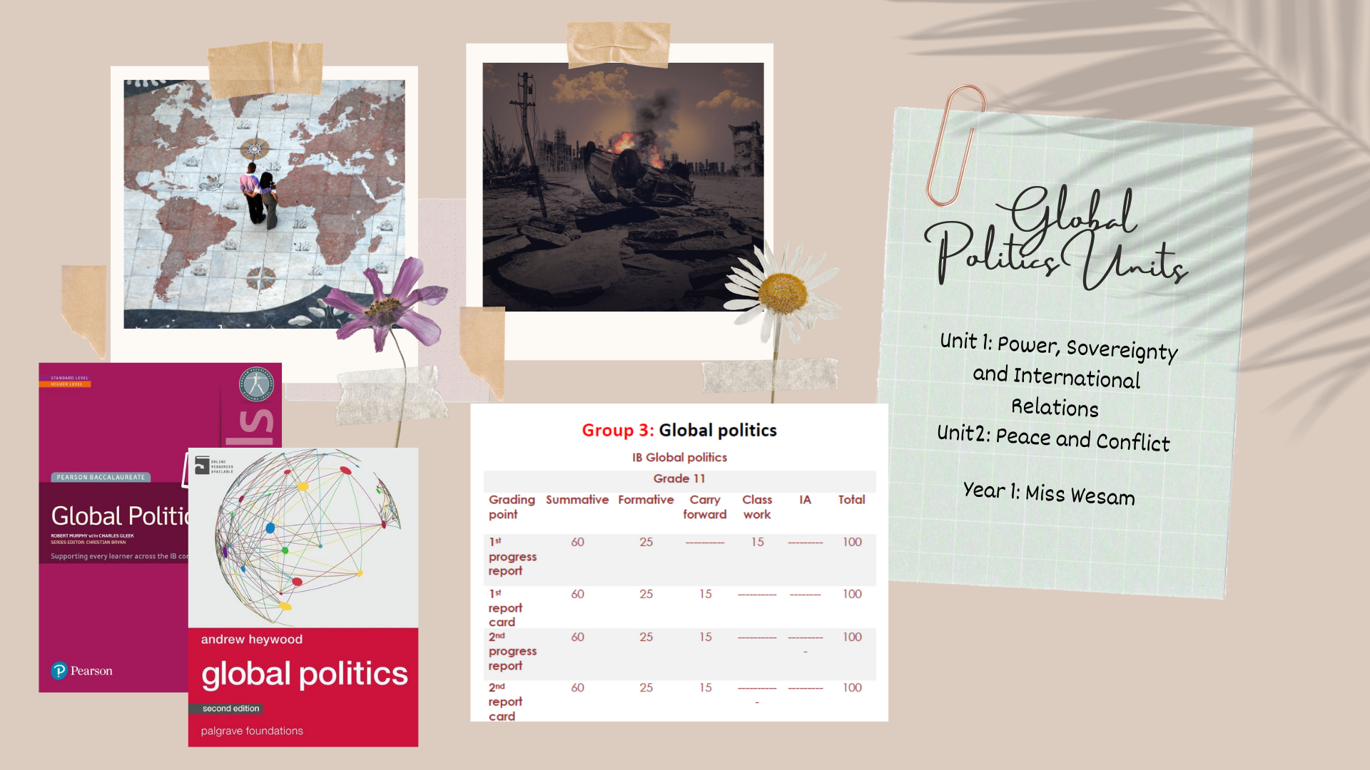
Ms. Hanin
Distinction between SL & HL:
- Paper 2
- HL Extensions

Slide 12

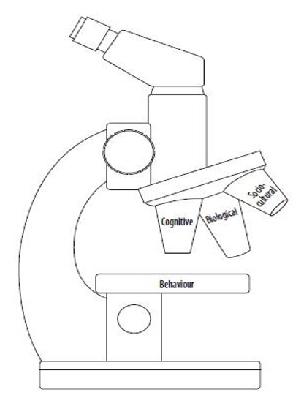

DISTINCTION BETWEEN HL & SL
HL has core extensions: the effects of globalization, technology and cognition, and animal research.
HL has one more option than SL in Paper 2. This unit will be Developmental Psychology
HL has paper 3 in which you have to answer questions about a piece of research which students have not seen before.
Resources
Google Classroom
ThinkIB.net
Kognity
Study Guide
Knowledge & Comprehension
Application & Analysis
Synthesis & Evaluation
Skills such as data analysis & interpretation
Assessment
Objectives
Ms. Reham Barghouti

Slide 13
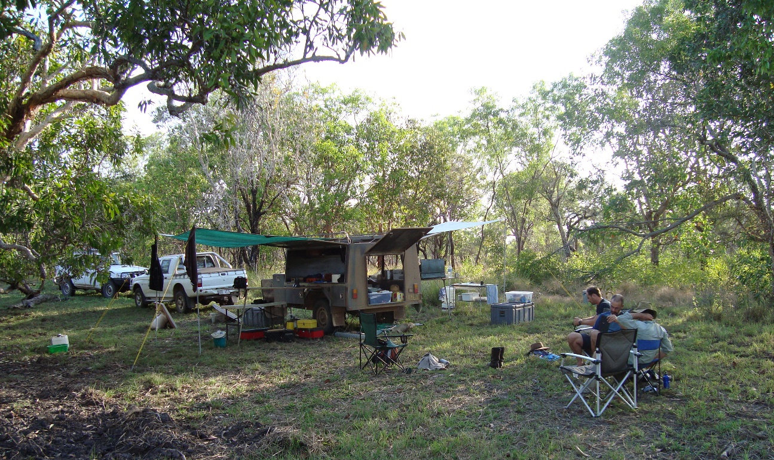
We will be covering the following topics
1. Foundations of ESS
2. Ecosystems and Ecology
3. Soil Systems
4. Aquatic Systems
*Internal Assessment in April
Assessment
Pop quiz
Lab and Fieldwork
Tests
Environmental Systems and Societies (ESS) Grade 11

Slide 14
DP Design Technology
DO: Skills
UNDERSTAND the design thinking process
EXPLORE: Case Studies in Design
LISTEN: 99% Invisible Podcast
APPLY technologies and techniques into making

Slide 15
The following topics will be covered in Grade 11
Topic title | Based on the syllabus
Measurements and Uncertainties | Topic 1
Mechanics | Topic 2
Circular motion and gravitation | Topic 6
Gravitational field (HL only) | Topic 10 (Gravitational part)
Thermal Physics | Topic 3
Waves | Topic 4 (plus the sub topic 9.1(HL)
Wave phenomena (HL only) | Topic 9 (HL)

Slide 16
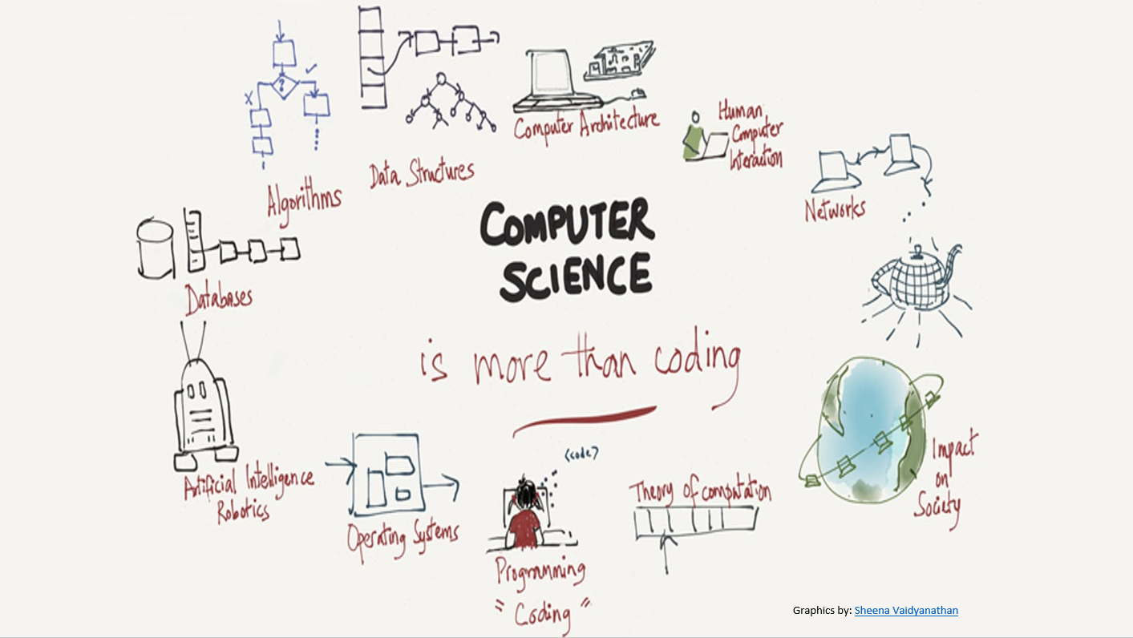

Slide 17
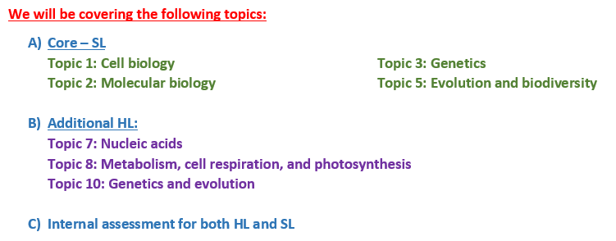
Biology Grade 11

Slide 18

Topic Titles – Grade 11 Chemistry 2021-2022
Quantitative Chemistry
Atomic Structure
Periodicity
Bonding
Energetics
Organic Chemistry
Measurement and Data Processing

Slide 19
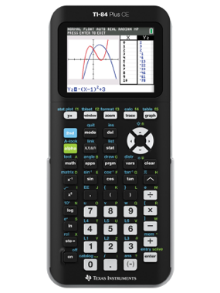
Mathematics: Analysis and Approaches
This course recognizes the need for analytical approach in a world where innovation is increasingly dependent on a deep understanding of mathematics.
Conceptual Understanding
Mathematical inquiry, mathematical modelling
Use of technology
Proof is an essential element in developing critical thinking
Five topics and within these topics there are sub-topics. These are
Number and Algebra
Functions
Geometry and Trigonometry
Probability and Statistics
Calculus
Each topic begins with SL content followed by HL content.
Mandatory Equipment:
Texas TI-84 calculator

Slide 20
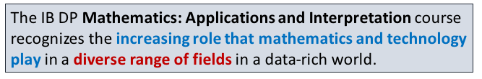
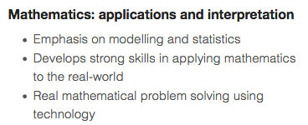
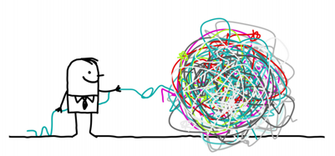

Mathematics: Applications and Interpretation
Mandatory Equipment:
Texas TI-84 calculator
Topics Studied:

Slide 21
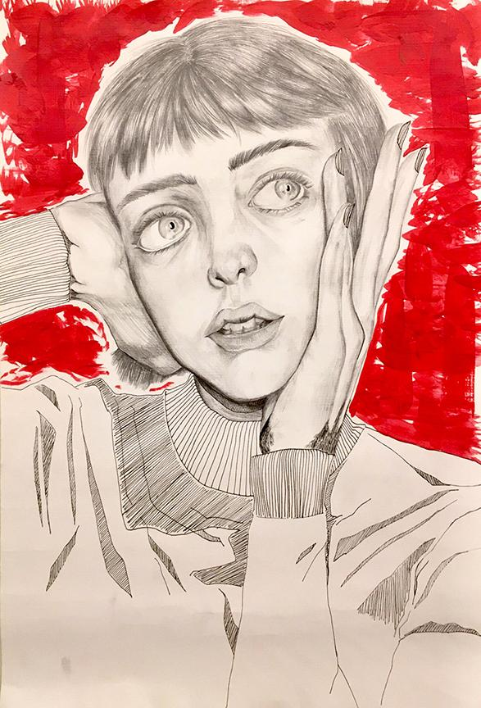

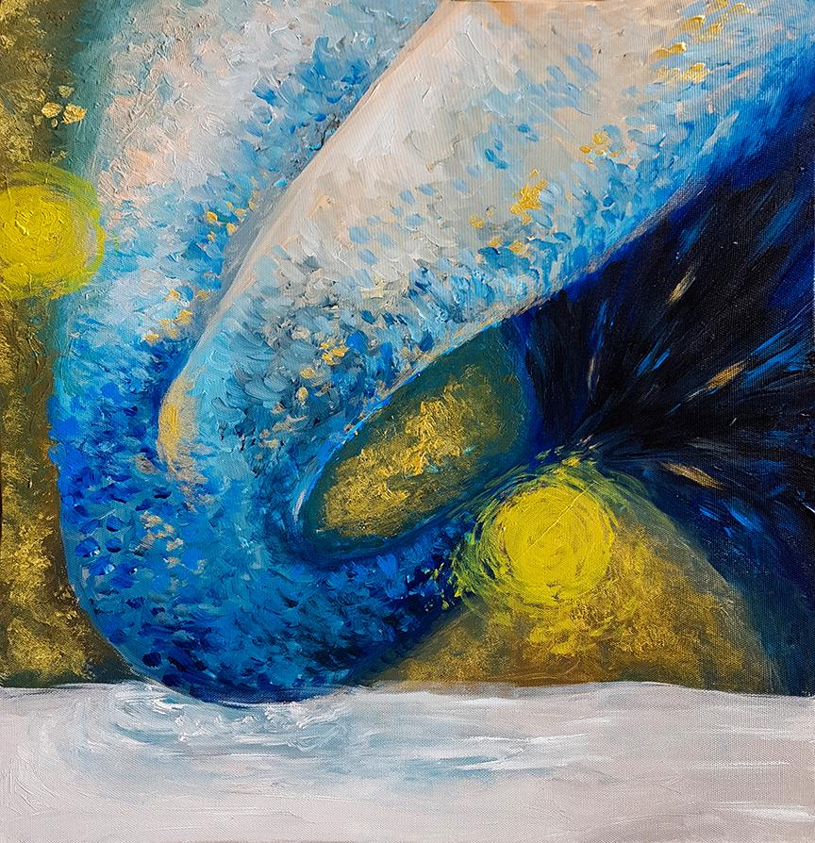
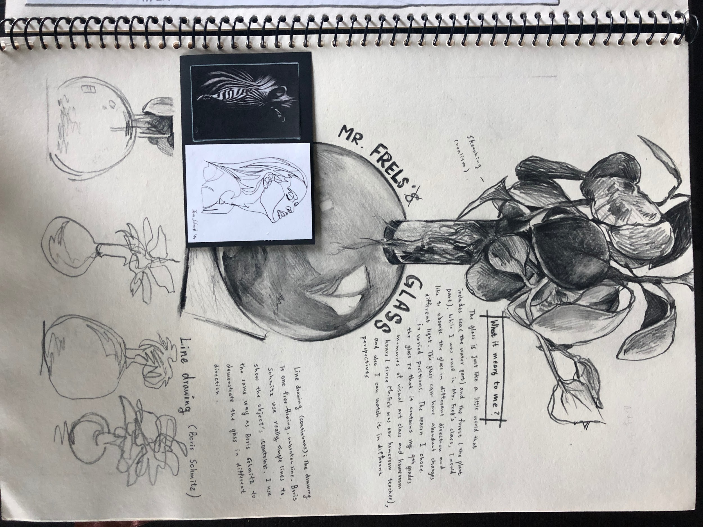
Arts Department - Grade 11 - Diploma Program
Visual Arts: Valerie Roche
Visual Arts Units:
Object Study
Expressive 2D Self Portrait
Cyanotype Photography
Cultural Identity
Student Initiated Project
Student Initiated Project
Types of Assessments
Visual Journal
Studio Artwork
Art Analysis (written form)

Slide 22
