Slide 1
Assessment in the MYP a short guide for parents
The International Academy of Amman

Slide 2
What is assessment?
“The evaluation of the ability of a student”
usually using an assessment task
Examples:
Test
Essay
Presentation
Experiment
Experiment Report
Artwork
Performance
Product

Slide 3
Internal / Continuous / External
Internal
Tasks, strategies and tools are designed, developed and applied by IAA teachers.
Continuous
Takes places throughout the programme.
External – G10 only
Not in 2020
E-assessments:
E-coursework / E-portfolio
Online examinations

Slide 4
AIMS of Assessment in the myp
To support and encourage student learning by providing feedback on the learning process
To promote a deep understanding of subject content by supporting students in their inquiries set in real-world contexts
To promote the development of critical and creative-thinking skills
To inform, enhance and improve the teaching process

Slide 5
types of Assessment
Formative
ongoing
provides information to guide teaching and improve student performance.
Information is unlikely to be used for deriving grades
Excellent, Very Good, Good, Satisfactory, Needs Improvement
They should be short!
Summative
culminating assessment for a unit, term or course of study
provides information on a student’s achievement level against specific objectives.

Slide 6
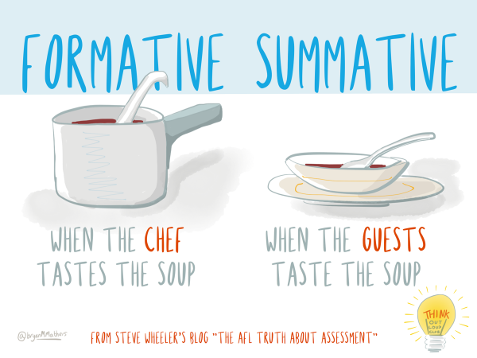

Slide 7
Most important purpose – to support Student Learning
For the student:
gathering and analysis of information
feedback to students
provide a basis for practice
For the teacher:
identify student learning needs
Plan accordingly

Slide 8
ASSESSMENT CALENDAR (g6) - MOODLE

Slide 9
Objectives
Specific targets that are set for learning in the subject by the IB
Define what the student should be able to accomplish as a result of studying the subject

Slide 10
Objectives
Published by the IB
Subject | A | B | C | D
Language & Literature | Analysing | Organising | Producing Text | Using Language
Language Acquisition | Comprehending Spoken and Visual Text | Comprehending Written and Visual Text | Communicating in Response to Spoken, Written and Visual Text | Using Language in Spoken and Written Form
Individuals and Societies | Knowing and Understanding | Investigating | Communicating | Critical Thinking
Sciences | Knowing and Understanding | Inquiring and Designing | Processing and Evaluating | Reflecting on the Impacts of Science
Mathematics | Knowing and Understanding | Investigating Patterns | Communicating | Applying Mathematics in Real-Life Contexts
Arts | Knowing and Understanding | Developing Skills | Thinking Creatively | Responding
Design | Inquiring and Analysing | Developing Ideas | Creating the Solution | Evaluating
Physical and Health Education | Knowing and Understanding | Planning for Performance | Applying and Performing | Reflecting and Improving Performance

Slide 11
Objectives
Published by the IB
Subject | A | B | C | D
Language & Literature | Analysing | Organising | Producing Text | Using Language
Language Acquisition | Comprehending Spoken and Visual Text | Comprehending Written and Visual Text | Communicating in Response to Spoken, Written and Visual Text | Using Language in Spoken and Written Form
Individuals and Societies | Knowing and Understanding | Investigating | Communicating | Critical Thinking
Sciences | Knowing and Understanding | Inquiring and Designing | Processing and Evaluating | Reflecting on the Impacts of Science
Mathematics | Knowledge and Understanding | Investigating Patterns | Communicating | Applying Mathematics in Real-Life Contexts
Arts | Knowledge and Understanding | Developing Skills | Thinking Creatively | Responding
Design | Inquiring and Analysing | Developing Ideas | Creating the Solution | Evaluating
Physical and Health Education | Knowing and Understanding | Planning for Performance | Applying and Performing | Reflecting and Improving Performance

Slide 12
Objective D: REFLECTING ON THE IMPACT OF SCIENCE
By the end of Year 5 (G10), students should be able to:
i. explain the ways in which science is applied and used to address a specific problem or issue
ii. discuss and evaluate the various implications of using science and its application to solve a specific problem or issue
iii. apply scientific language effectively
iv. document the work of others and sources of information used.
Published by the IB

Slide 13
How is student achievement of the final objectives measured (or assessed)?
Published Assessment Criteria

Slide 14
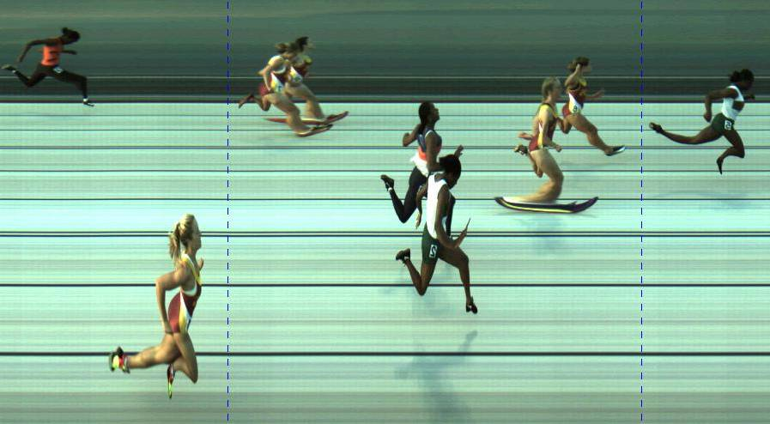
Criterion –Based Assessment
Level 2
Level 6

Slide 15
ASSESSMENT CRITERIA
Published by the IB
Subject | A | B | C | D
Language & Literature (32) | Analysing (8) | Organising (8) | Producing Text (8) | Using Language (8)
Language Acquisition (32) | Comprehending Spoken and Visual Text (8) | Comprehending Written and Visual Text (8) | Communicating in Response to Spoken, Written and Visual Text (8) | Using Language in Spoken and Written Form (8)
Individuals and Societies (32) | Knowing and Understanding (8) | Investigating (8) | Communicating (8) | Critical Thinking (8)
Sciences (32) | Knowing and Understanding (8) | Inquiring and Designing (8) | Processing and Evaluating (8) | Reflecting on the Impacts of Science (8)
Mathematics (32) | Knowing and Understanding (8) | Investigating Patterns (8) | Communicating (8) | Applying Maths in Real-Life Contexts (8)
Arts (32) | Knowing and Understanding (8) | Developing Skills (8) | Thinking Creatively (8) | Responding (8)
Design (32) | Inquiring and Analysing (8) | Developing Ideas (8) | Creating the Solution (8) | Evaluating (8)
Physical and Health Education (32) | Knowing and Understanding (8) | Planning for Performance (8) | Applying and Performing (8) | Reflecting and Improving Performance (8)

Slide 16
ASSESSMENT CRITERIA
Published by the IB
Subject | A | B | C | D
Language & Literature (32) | Analysing (8) | Organising (8) | Producing Text (8) | Using Language (8)
Language Acquisition (32) | Comprehending Spoken and Visual Text (8) | Comprehending Written and Visual Text (8) | Communicating in Response to Spoken, Written and Visual Text (8) | Using Language in Spoken and Written Form (8)
Individuals and Societies (32) | Knowing and Understanding (8) | Investigating (8) | Communicating (8) | Critical Thinking (8)
Sciences (32) | Knowing and Understanding (8) | Inquiring and Designing (8) | Processing and Evaluating (8) | Reflecting on the Impacts of Science (8)
Mathematics (32) | Knowledge and Understanding (8) | Investigating Patterns (8) | Communicating (8) | Applying Maths in Real-Life Contexts (8)
Arts (32) | Knowledge and Understanding (8) | Developing Skills (8) | Thinking Creatively (8) | Responding (8)
Design (32) | Inquiring and Analysing (8) | Developing Ideas (8) | Creating the Solution (8) | Evaluating (8)
Physical and Health Education (32) | Knowing and Understanding (8) | Planning for Performance (8) | Applying and Performing (8) | Reflecting and Improving Performance (8)

Slide 17
Criterion D: Reflecting on the impact of science
Achieve-ment Level | Level Descriptor Year 5 student is able to:
1-2 | i. outline the ways in which science is used to address a specific problem or issue ii. outline the implications of using science to solve a specific problem or issue, interacting with a factor iii. apply scientific language to communicate understanding but does so with limited success iv. document sources, with limited success.
3-4 | i. summarize the ways in which science is applied and used to address a specific problem or issue ii. describe the implications of using science and its application to solve a specific problem or issue, interacting with a factor iii. sometimes apply scientific language to communicate understanding iv. sometimes document sources correctly.
5-6 | i. describe the ways in which science is applied and used to address a specific problem or issue ii. discuss the implications of using science and its application to solve a specific problem or issue, interacting with a factor iii. usually apply scientific language to communicate understanding clearly and precisely iv. usually document sources correctly.
7-8 | i. explain the ways in which science is applied and used to address a specific problem or issue ii. discuss and evaluate the implications of using science and its application to solve a specific problem or issue, interacting with a factor iii. consistently apply scientific language to communicate understanding clearly and precisely iv. document sources completely.
Published by the IB

Slide 18
Criterion D: Reflecting on the impact of science
Achieve-ment Level | Level Descriptor Year 5 student is able to:
7-8 | i.explain the ways in which science is applied and used to address a specific problem or issue ii. discuss and evaluate the implications of using science and its application to solve a specific problem or issue, interacting with a factor iii. consistently apply scientific language to communicate understanding clearly and precisely iv. document sources completely.
Published by the IB

Slide 19
Assessing Student’s Work
Task-specific rubrics are provided
Students note the highest level as the one to strive for
Teacher assesses the work, starting with the descriptor for the lowest level, until reaching a descriptor for a level of achievement the work has not attained

Slide 20
Sample Science Task: Water Crisis
How can science be applied to address
the water crisis in Jordan?
Discuss the factors that have contributed to the water crisis in the Jordan.
Choose 1 method to explain how science is applied to solve the water crisis.
Describe the positive and negative effects of the above method in solving the water crisis.
Document your sources according to MLA format

Slide 21
Task-Specific Rubric
1-2 | 3-4 | 5-6 | 7-8
I stated the method that can be used to address the water problem in Jordan. | I outlined the method that can be used to address the water problem in Jordan. | I summarized the method that can be used to address the water problem in Jordan. | I described the method that can be used to address the water problem in Jordan.
I stated the advantages or disadvantages of the method to solve the water problem | I outlined the advantages or disadvantages of the method to solve the water problem | I described the advantages or disadvantages of the method to solve the water problem | I discussed the advantages and disadvantages of the method to solve the water problem
I stated how this method interacts with one of the following factors: social, economic, political, environmental, cultural or ethical. | I outlined how this method interacts with one of the following factors: social, economic, political, environmental, cultural or ethical. | I described how this method interacts with one of the following factors: social, economic, political, environmental, cultural or ethical. | I discussed how this method interacts with one of the following factors: social, economic, political, environmental, cultural or ethical.
I used scientific language to communicate my understanding clearly and precisely but with limited success. | I sometimes used scientific language to communicate my understanding clearly and precisely. | Most of the time, I used scientific language to communicate my understanding clearly and precisely. | I consistently used scientific language to communicate my understanding clearly and precisely.
I documented sources but with limited success. | I sometimes documented sources correctly using MLA format. | Most of the time, I documented sources correctly using MLA format. | I documented sources correctly using MLA format.

Slide 22
Task-Specific Rubric
1-2 | 3-4 | 5-6 | 7-8
I stated the method that can be used to address the water problem in Jordan. | I outlined the method that can be used to address the water problem in Jordan. | I summarized the method that can be used to address the water problem in Jordan. | I described the method that can be used to address the water problem in Jordan.
I stated the advantages or disadvantages of the method to solve the water problem | I outlined the advantages or disadvantages of the method to solve the water problem | I described the advantages or disadvantages of the method to solve the water problem | I discussed the advantages and disadvantages of the method to solve the water problem
I stated how this method interacts with one of the following factors: social, economic, political, environmental, cultural or ethical. | I outlined how this method interacts with one of the following factors: social, economic, political, environmental, cultural or ethical. | I described how this method interacts with one of the following factors: social, economic, political, environmental, cultural or ethical. | I discussed how this method interacts with one of the following factors: social, economic, political, environmental, cultural or ethical.
I used scientific language to communicate my understanding clearly and precisely but with limited success. | I sometimes used scientific language to communicate my understanding clearly and precisely. | Most of the time, I used scientific language to communicate my understanding clearly and precisely. | I consistently used scientific language to communicate my understanding clearly and precisely.
I documented sources but with limited success. | I sometimes documented sources correctly using MLA format. | Most of the time, I documented sources correctly using MLA format. | I documented sources correctly using MLA format.

Slide 23
Best Fit for Reporting
For each subject, each criterion should be assessed a minimum of two times over the year
Teacher uses professional judgement to determine the final level of the student at that point in time based on the summative assessments taken. If this is not clear, then we may look to formative assessments to help guide decision making.
NOT an arithmetical average
NO fractions – whole numbers only
All of the criterion levels for that subject are added together
The total is converted to a 1 – 7 grade using a “grade level boundary” table

Slide 24
Task Name & Description | Criterion (A) | Criterion (B) | Criterion (C) | Criterion (D)
An analytical essay on a topic in WWI | 5 |  | 6
2. A presentation on Trench Warfare |  | 7 |  | 5
3. An end of unit test: Causes of WWI | 7 | 6
4. A Propaganda Poster during Communist China |  | 6 |  | 7
5. An essay on reasons for the Bolshevik Revolution | 4 |  | 7
6. A pamphlet spreading awareness on environment and sustainable energy. |  |  | 7 | 6
7. An end of Unit Test: Tourism | 6 | 8
8. Producing a model of a Medieval Castle |  |  | 5 | 6
Best- Fit/ Final Judgment
Total out of (32)
Total out of (7)

Slide 25
Task Name & Description | Criterion (A) | Criterion (B) | Criterion (C) | Criterion (D)
An analytical essay on a topic in WWI | 5 |  | 6
2. A presentation on Trench Warfare |  | 7 |  | 5
3. An end of unit test: Causes of WWI | 7 | 6
4. A Propaganda Poster during Communist China |  | 6 |  | 7
5. An essay on reasons for the Bolshevik Revolution | 4 |  | 7
6. A pamphlet spreading awareness on environment and sustainable energy. |  |  | 7 | 6
7. An end of Unit Test: Tourism | 6 | 8
8. Producing a model of a Medieval Castle |  |  | 5 | 6
Best- Fit/ Final Judgment | 6 | 6 | 7 | 6
Total out of (32) | 25
Total out of (7)

Slide 26
Task Name & Description | Criterion (A) | Criterion (B) | Criterion (C) | Criterion (D)
An analytical essay on a topic in WWI | 5 |  | 6
2. A presentation on Trench Warfare |  | 7 |  | 5
3. An end of unit test: Causes of WWI | 7 | 6
4. A Propaganda Poster during Communist China |  | 6 |  | 7
5. An essay on reasons for the Bolshevik Revolution | 4 |  | 7
6. A pamphlet spreading awareness on environment and sustainable energy. |  |  | 7 | 6
7. An end of Unit Test: Tourism | 6 | 8
8. Producing a model of a Medieval Castle |  |  | 5 | 6
Best- Fit/ Final Judgment | 6 | 6 | 7 | 6
Total out of (32) | 25
Total out of (7) | 6
Grade | Boundary Guidelines
1 | 1-5
2 | 6-9
3 | 10-14
4 | 15-18
5 | 19-23
6 | 24-27
7 | 28-32

Slide 27
A grade 6 (Very good)
A consistent and thorough understanding of the required knowledge and skills, and the ability to apply them in a wide variety of situations. Consistent evidence of analysis, synthesis and evaluation is shown where appropriate. The student generally demonstrates originality and insight.

Slide 28
General Grade Descriptors
Grade | Descriptor
1 | Minimal achievement in terms of the objectives.
2 | Very limited achievement against all the objectives. The student has difficulty in understanding the required knowledge and skills and is unable to apply them fully in normal situations, even with support.
3 | Limited achievement against most of the objectives, or clear difficulties in some areas. The student demonstrates a limited understanding of the required knowledge and skills and is only able to apply them fully in normal situations with support.
4 | A good general understanding of the required knowledge and skills, and the ability to apply them effectively in normal situations. There is occasional evidence of the skills of analysis, synthesis and evaluation.
5 | A consistent and thorough understanding of the required knowledge and skills, and the ability to apply them in a variety of situations. The student generally shows evidence of analysis, synthesis and evaluation where appropriate and occasionally demonstrates originality and insight.
6 | A consistent and thorough understanding of the required knowledge and skills, and the ability to apply them in a wide variety of situations. Consistent evidence of analysis, synthesis and evaluation is shown where appropriate. The student generally demonstrates originality and insight.
7 | A consistent and thorough understanding of the required knowledge and skills, and the ability to apply them almost faultlessly in a wide variety of situations. Consistent evidence of analysis, synthesis and evaluation is shown where appropriate. The student consistently demonstrates originality and insight and always produces work of high quality.
1 | Very Poor
2 | Poor
3 | Mediocre
4 | Satisfactory
5 | Good
6 | Very good
7 | Excellent

Slide 29
Approaches to Learning skills
Reported on for each reporting period in terms of Excellent, Very Good, Good, Satisfactory and Needs Improvement.
Communication
Exchanging thoughts, messages and information effectively through interaction
Reading, writing and using language to gather and communicate information
Social
Working effectively with others
Self-management
Managing time and tasks effectively
Managing state of mind
Research
Finding, interpreting, judging and creating information
Interacting with media to use and create ideas and information
Thinking
Analysing and evaluating issues and ideas
Generating novel ideas and considering new perspectives

Slide 30
Progress Reports
Progress Report 1 – Best fit of Aug to Oct
Approaches to Learning Skills
Not all criteria may have been assessed
N/A will be placed in the relevant box.
Teacher comment
Grade out of 7
Progress Report 2 – Best fit of Aug to March
Approaches to Learning Skills
Achievement level for each criterion
Teacher comment
Grade out of 7

Slide 31
SEMESTER Report Card
Semester 1
Best fit of Aug to Jan
End of Year
Best fit of Aug to June
Both include achievement level for each criterion and rating of Approaches to Learning Skills

