Slide 1
Interdisciplinary Learning
At IAA

Slide 2
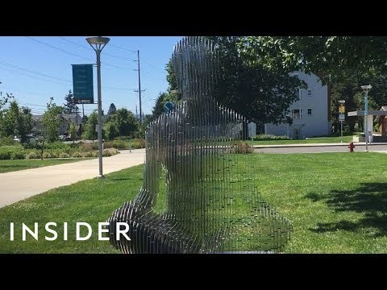
How did German artist, Julian Voss-Andreae, do it?

Slide 3
Do we use skills and knowledge in isolation?

Slide 4
What is INTEDISCIPLINARY LEARNING?
Interdisciplinary learning takes place between different subject groups to encourage broader perspectives on complex issues and deeper levels of analysis and synthesis.
It is the process by which students come to understand bodies of knowledge and modes of thinking from two or more disciplines and then integrate them to create a new understanding.
(cited from IB MYP Subject Brief Interdisciplinary Learning: http://www.ibo.org/globalassets/digital-tookit/brochures/myp-brief-interdisciplinary-learning-2015-en.pdf).

Slide 5
Myp Certificate requirements
Five on-screen examinations (one from each of four required subject groups, plus an interdisciplinary assessment)
One ePortfolio from a course of study in Language Acquisition
One ePortfolio from a course in Physical and Health Education, Arts or Design
The Personal Project
Students must meet the school’s expectations for SAA.

Slide 6
For Grades 6 to 9
students complete one interdisciplinary unit (IDU) per semester.
The grades for the first IDU will be reported in the first semester report card
The grades for the second IDU will be reported in end of year report card
The IDU grade will count in the student’s overall GPA

Slide 7
In Grade 10
Students will complete an IDU in first semester
In second semester, the stimulus material released by the IB in early April, for the Interdisciplinary exam, will be used to create a mock IDU e-assessment
The results for that mock exam will be the IDU grade, which will be reported on the End of Year report card

Slide 8
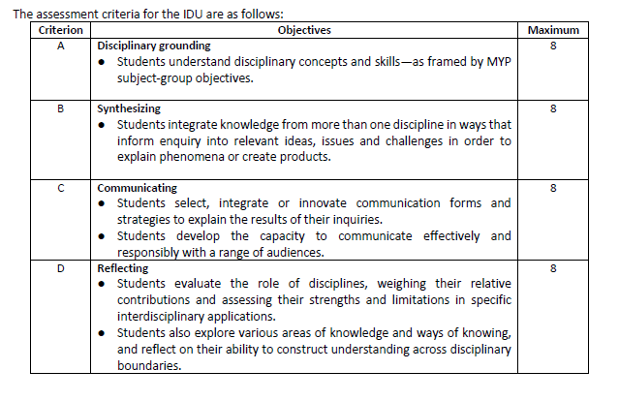
Special IDU Criteria

Slide 9
OUR Interdisciplinary units
Grade | Unit(s)
6 | Individuals and Societies + Arabic Language and literature Students learn how to use language in order to promote and preserve the cultural heritage of Petra.
7 | Science + PHE Students learn that all body systems are interdependent and that a person’s health is influenced by cultural and conditional changes. They accordingly learn how to lead a healthy lifestyle. | English L&L + IAS Students write persuasively to explore and present their views on the human impact on the environment
8 | Arabic L&L + PHE Students learn about health programmes and the importance of making healthy choices. They then translate that into an informative booklet | English L&L+ IAS Students learn to communicate with a wider audience in order to resolve certain global issues such as Covid-19.

Slide 10
Grade | Units
9 | Math+ Science Students apply concepts of gradient, linear relationship of direct variation and skill of sketching graphs (mathematics) to express and determine the relationship between two different scientific variables | English L&L+IAS Students learn to effectively narrate the personal history of Jordanians, migrants and immigrants to shed light on their journey and experience through a TED-talk-like presentation.
10 | English L&L+ IAS Students will explore how in order to advance fairness and development, organisations can utilize a variety of mediums and perspectives for the purpose of connecting with the public | IB MATERIAL RELEASED IN APRIL

Slide 11
Questions?

