Slide 1
Workshop for parents Thursday- September 3RD ZOOM SESSION
Sep 2020

Slide 2
To get you thinking……
What do you already know about the MYP….

Slide 4
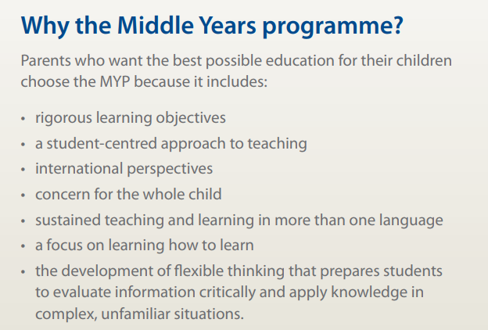

Slide 5
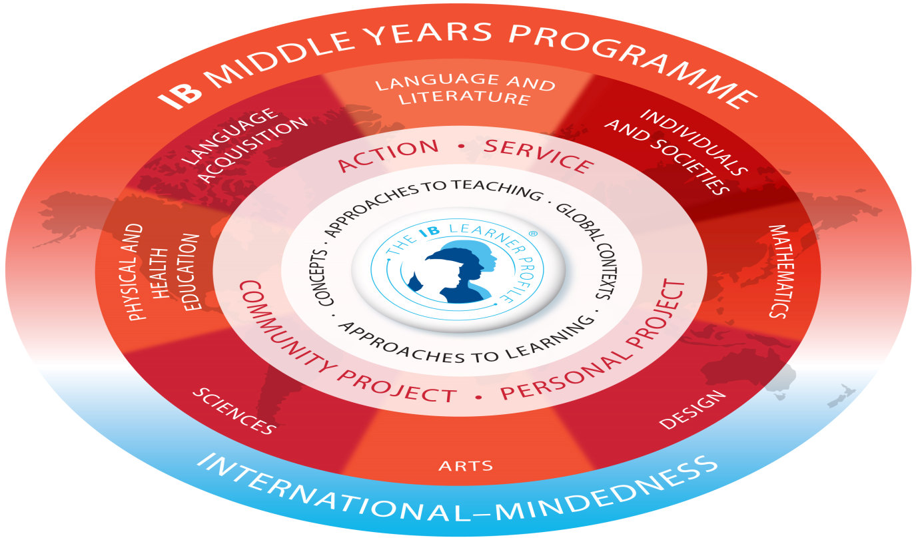

Slide 7
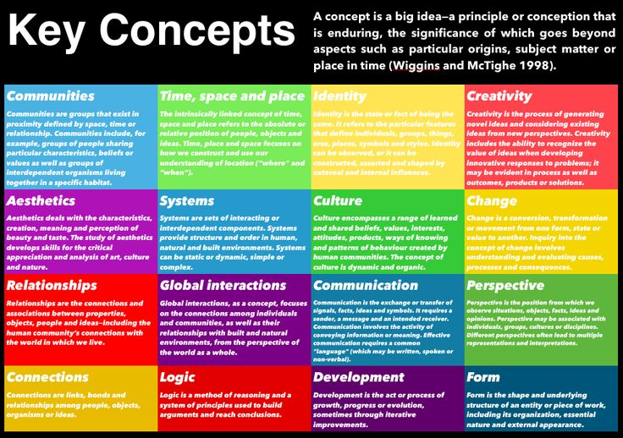

Slide 8
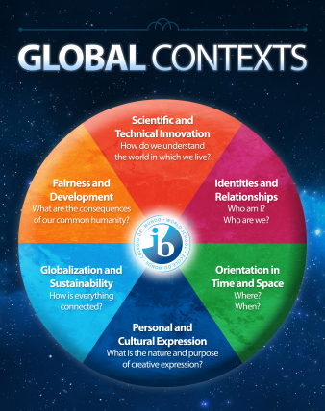

Slide 9
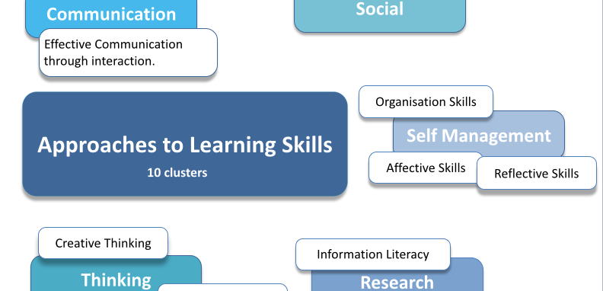
Approaches to Learning Skills

Slide 10
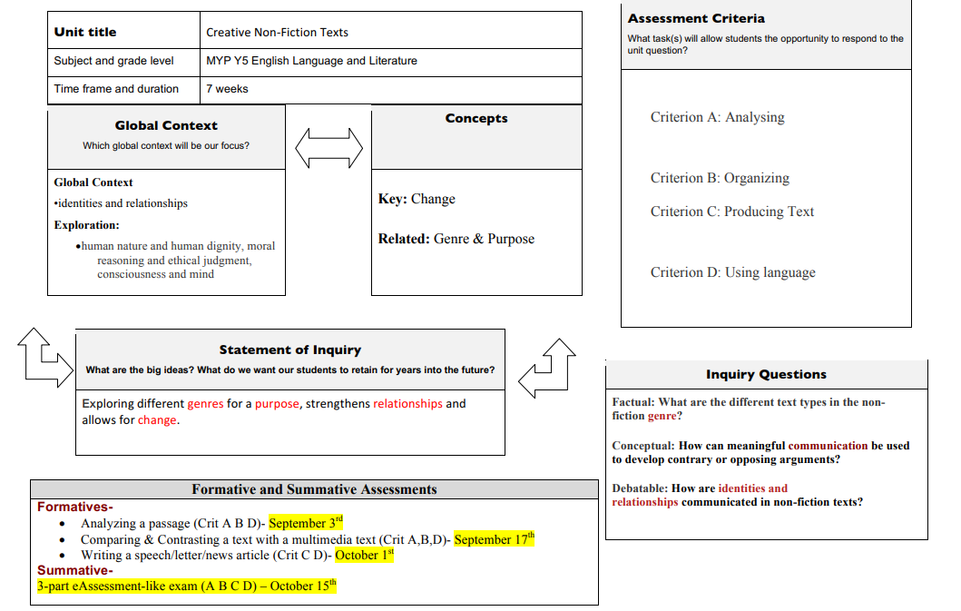

Slide 13
In the MYP interdisciplinary learning is defined as the process by which students come to understand knowledge and ways of thinking from two or more disciplines or subject groups to create a new integrated understanding.

Slide 14
Service as Action
Using the curriculum, students are guided to take actions that can serve their community

Slide 15
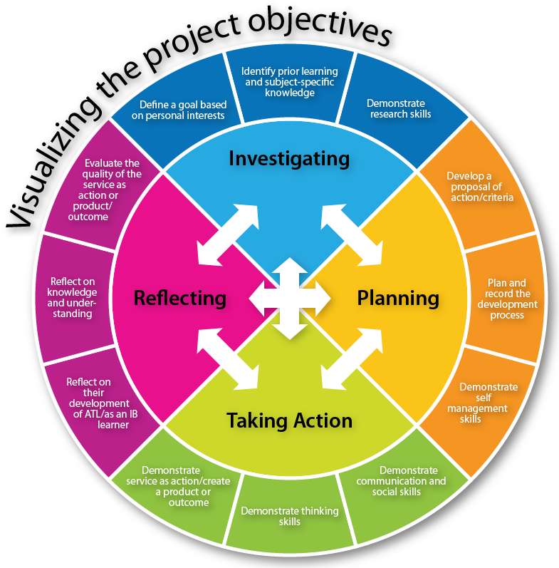
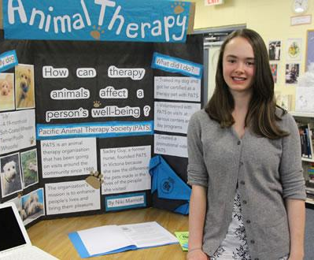
Projects
G8 – Community Project
G9 /10 – Personal Project

Slide 16
The Role of the Library
Research Databases: JSTOR, Britannica School, Science Today and more
Help with Academic Honesty in the MYP
Information and Media Literacy
Encourage reading for personal growth

Slide 17
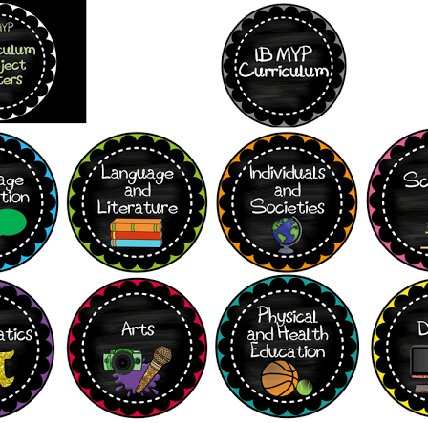
MYP Subjects
At the IAA we do:
Both Arabic and English Language and Literature
Arabic and Spanish Language Acquisition
Arabic and English Individuals and Societies
From G9 – discrete or integrated sciences
Visual Art, Music and Drama

Slide 18
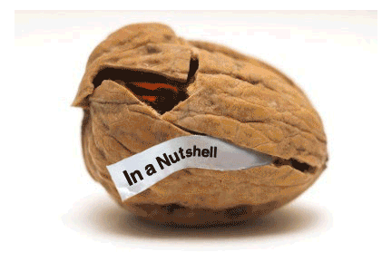
In a nutshell...
MYP is about inquiry-based learning using big ideas
It is not about memorizing content
As a teacher you need to find ways to get students to “unpack” these ideas in the classroom.

