Slide 1
Service As Action At IAA
Zeina Zananiri
Hanin Ababneh

Slide 2
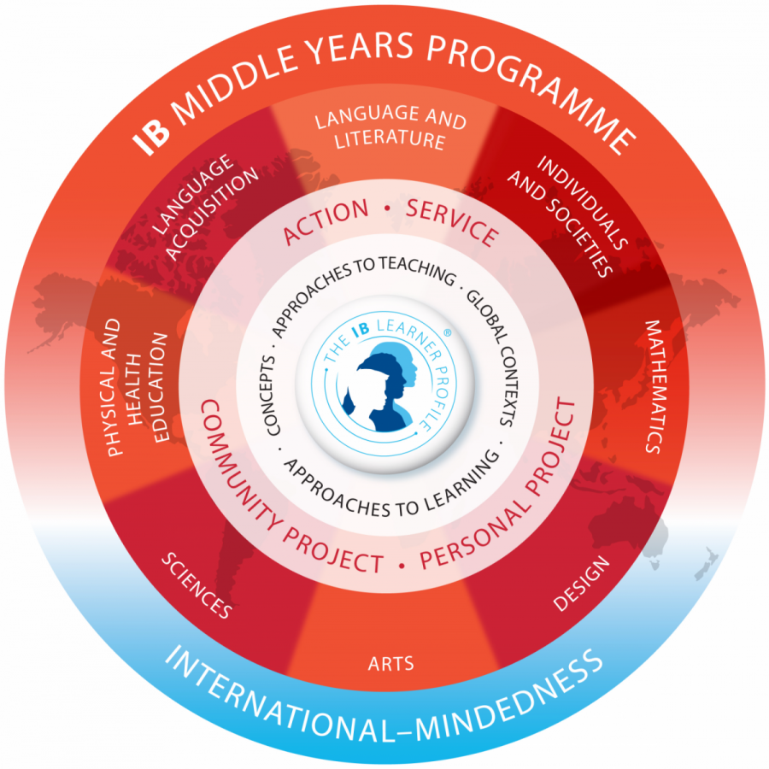

Slide 3
IB Mission statement
The International Baccalaureate aims to develop inquiring, knowledgeable and caring young people who help to create a better and more peaceful world through intercultural understanding and respect. To this end the organization works with schools, governments and international organizations to develop challenging programmes of international education and rigorous assessment. These programmes encourage students across the world to become active, compassionate and lifelong learners who understand that other people, with their differences, can also be right.

Slide 4
Connecting school world to our world

Slide 5
Types of Service
Direct
Students interact with recipients
Indirect
Students do not interact directly with the recipients but offer a service remotely
Research Based
Collect information/data to influence a policy or to inform a wider audience
Advocacy
Speak on behalf of a cause or concern to promote action: raising awareness/ produce a play/ create a video

Slide 6
MYP outcomes of SAA
Become more aware of their own strengths and areas of growth
Undertake challenges that develop new skills
Discuss, evaluate and plan students initiated activities
Preserve in action
Work collaboratively with others
Develop international-mindedness through global engagement, multilingualism, and intercultural understanding
Consider the ethical implications of their actions

Slide 7
When and how do we do it?
1 Service Learning Unit per grade level
The Service component is embedded in a Disciplinary unit of study (could be an Interdisciplinary Unit- IDU)
In grade 6, the Service is related to their PSHE classes
Units are planned according to the SAA inquiry cycle (IPARD Cycle)
There are 5 stages: Investigating, Planning, Taking Action, Reflecting and Demonstrating (IPARD cycle)
Investigating, Planning and Reflecting are mostly completed in class
The Action and Demonstrating stages usually take place outside of class (breaks, weekends, afterschool, etc.)
The Service component in the unit is not assessed
Student work is documented on Google Drive and Google Classroom

Slide 8
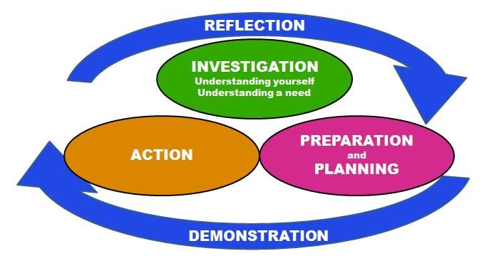

Slide 9
 | Subject Area Where SAA is embedded | Service Component
Grade 6 | PSHE | Composting: Students learn about their role in preserving the environment and how they can affect change by learning how to compost
Grade 7 | Individual and Societies (Eng.) | Exploring Human Rights Students learn about human rights and the role of the UN; they then work on different projects to express their views on these issues and perhaps offer solutions
Grade 8 | IDU: Individuals and Societies (Eng.)+ English Language & Literature + Science | Polio or COVID 19 Eradication Campaigns Students use language to affect change by creating campaigns and initiatives that support patients
Grade 9 | IDU: Individuals and Societies (Eng.) + English Language & Literature | The Jordan Narrative project Students investigate the journey of migrants, immigrants and locals who constitute the Jordanian society and learn how to tell their narratives
Grade 10 | English Language & Literature | Civil Society Research: Students learn about global social issues and relate them to local issues.

Slide 10
COVID 19 and Service Learning

Slide 11
Questions
Thank you

